Slide 1
Big Graph Analysis
COMP9312_22T2

Slide 2
Outline
Distributed Graph Algorithms
Graph Database
Other Graph Problems

Slide 3
Distributed Graph Algorithms

Slide 4
Distributed Processing is Non-Trivial
How to assign tasks to different workers in an efficient way?
What happens if tasks fail?
How do workers exchange results?
How to synchronize distributed tasks allocated to different workers?

Slide 5
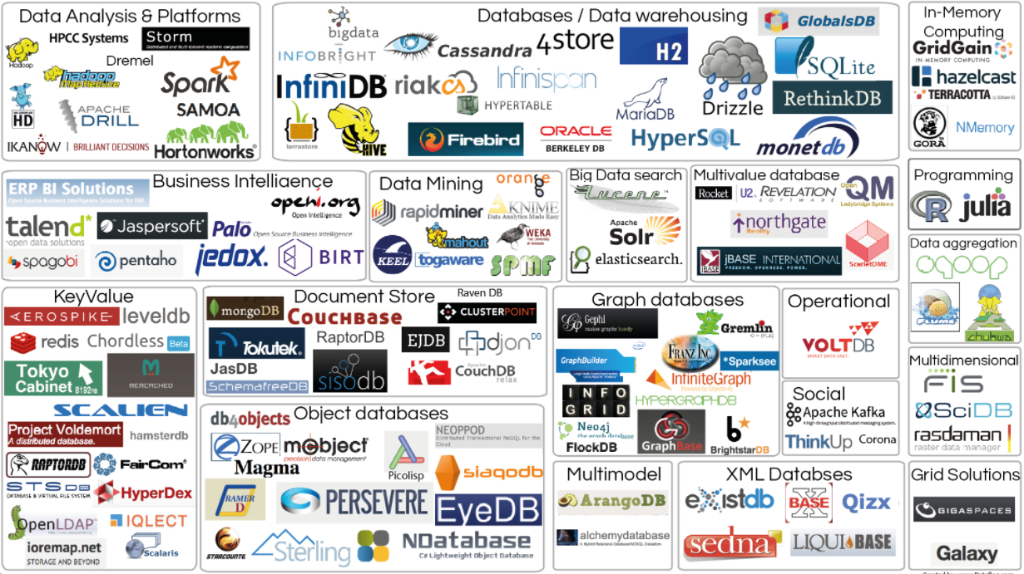
Big Data Tools

Slide 6
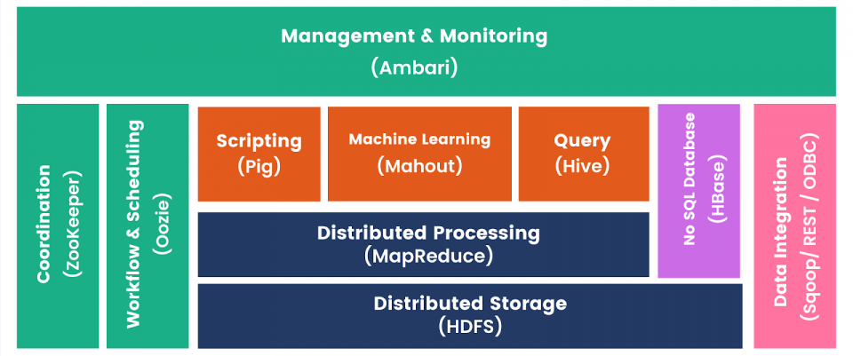
Apache Hadoop Ecosystem
We focus on the distributed computing model and algorithms.
Explore more in COMP9311~

Slide 7


MapReduce for General Big Data Processing
Origin from Google
[OSDI’04] MapReduce: Simplified Data Processing on Large Clusters
Programming model for parallel data processing
For large-scale data processing
Exploits large set of commodity computers
Executes process in a distributed manner
Offers high availability
Hadoop MapReduce is an implementation of MapReduce
MapReduce is a computing paradigm (Google)
Hadoop MapReduce is an open-source software

Slide 8
Typical Big Data Problem
Iterate over a large number of records
Extract something of interest from each
Shuffle and sort intermediate results
Aggregate intermediate results
Generate final output
Map
Reduce
Key idea: provide a functional abstraction for these two operations

Slide 9
Idea of MapReduce
Inspired by the map and reduce functions in functional programming
We can view map as a transformation over a dataset
This transformation is specified by the function f
Each functional application happens in isolation
The application of f to each element of a dataset can be parallelized in a straightforward manner
We can view reduce as an aggregation operation
The aggregation is defined by the function g
Data locality: elements in the list must be “brought together”
If we can group elements of the list, also the reduce phase can proceed in parallel
The framework coordinates the map and reduce phases:
Grouping intermediate results happens in parallel

Slide 10
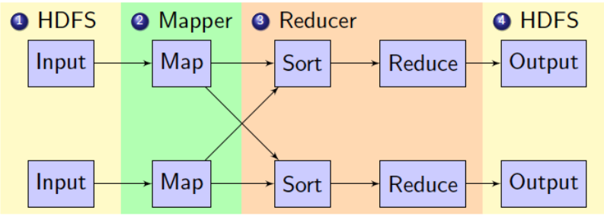
MapReduce Data Flow in Hadoop
1. Mappers read from HDFS
2. Map output is partitioned by key and sent to Reducers
3. Reducers sort input by key
4. Reduce output is written to HDFS
Intermediate results are stored on local FS of Map and Reduce workers

Slide 11
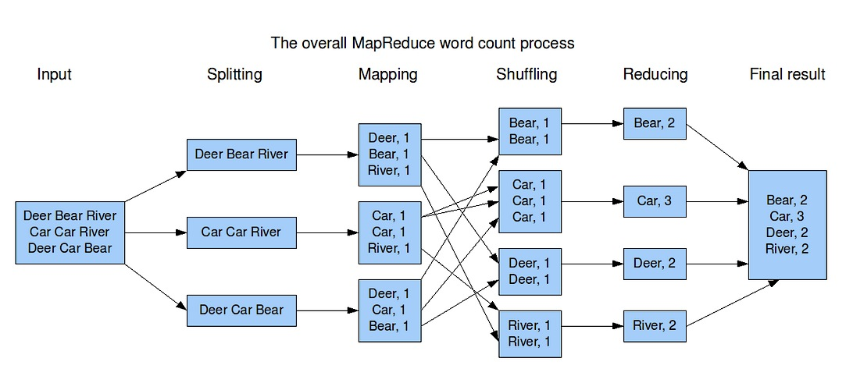
MapReduce Example - WordCount

Slide 12
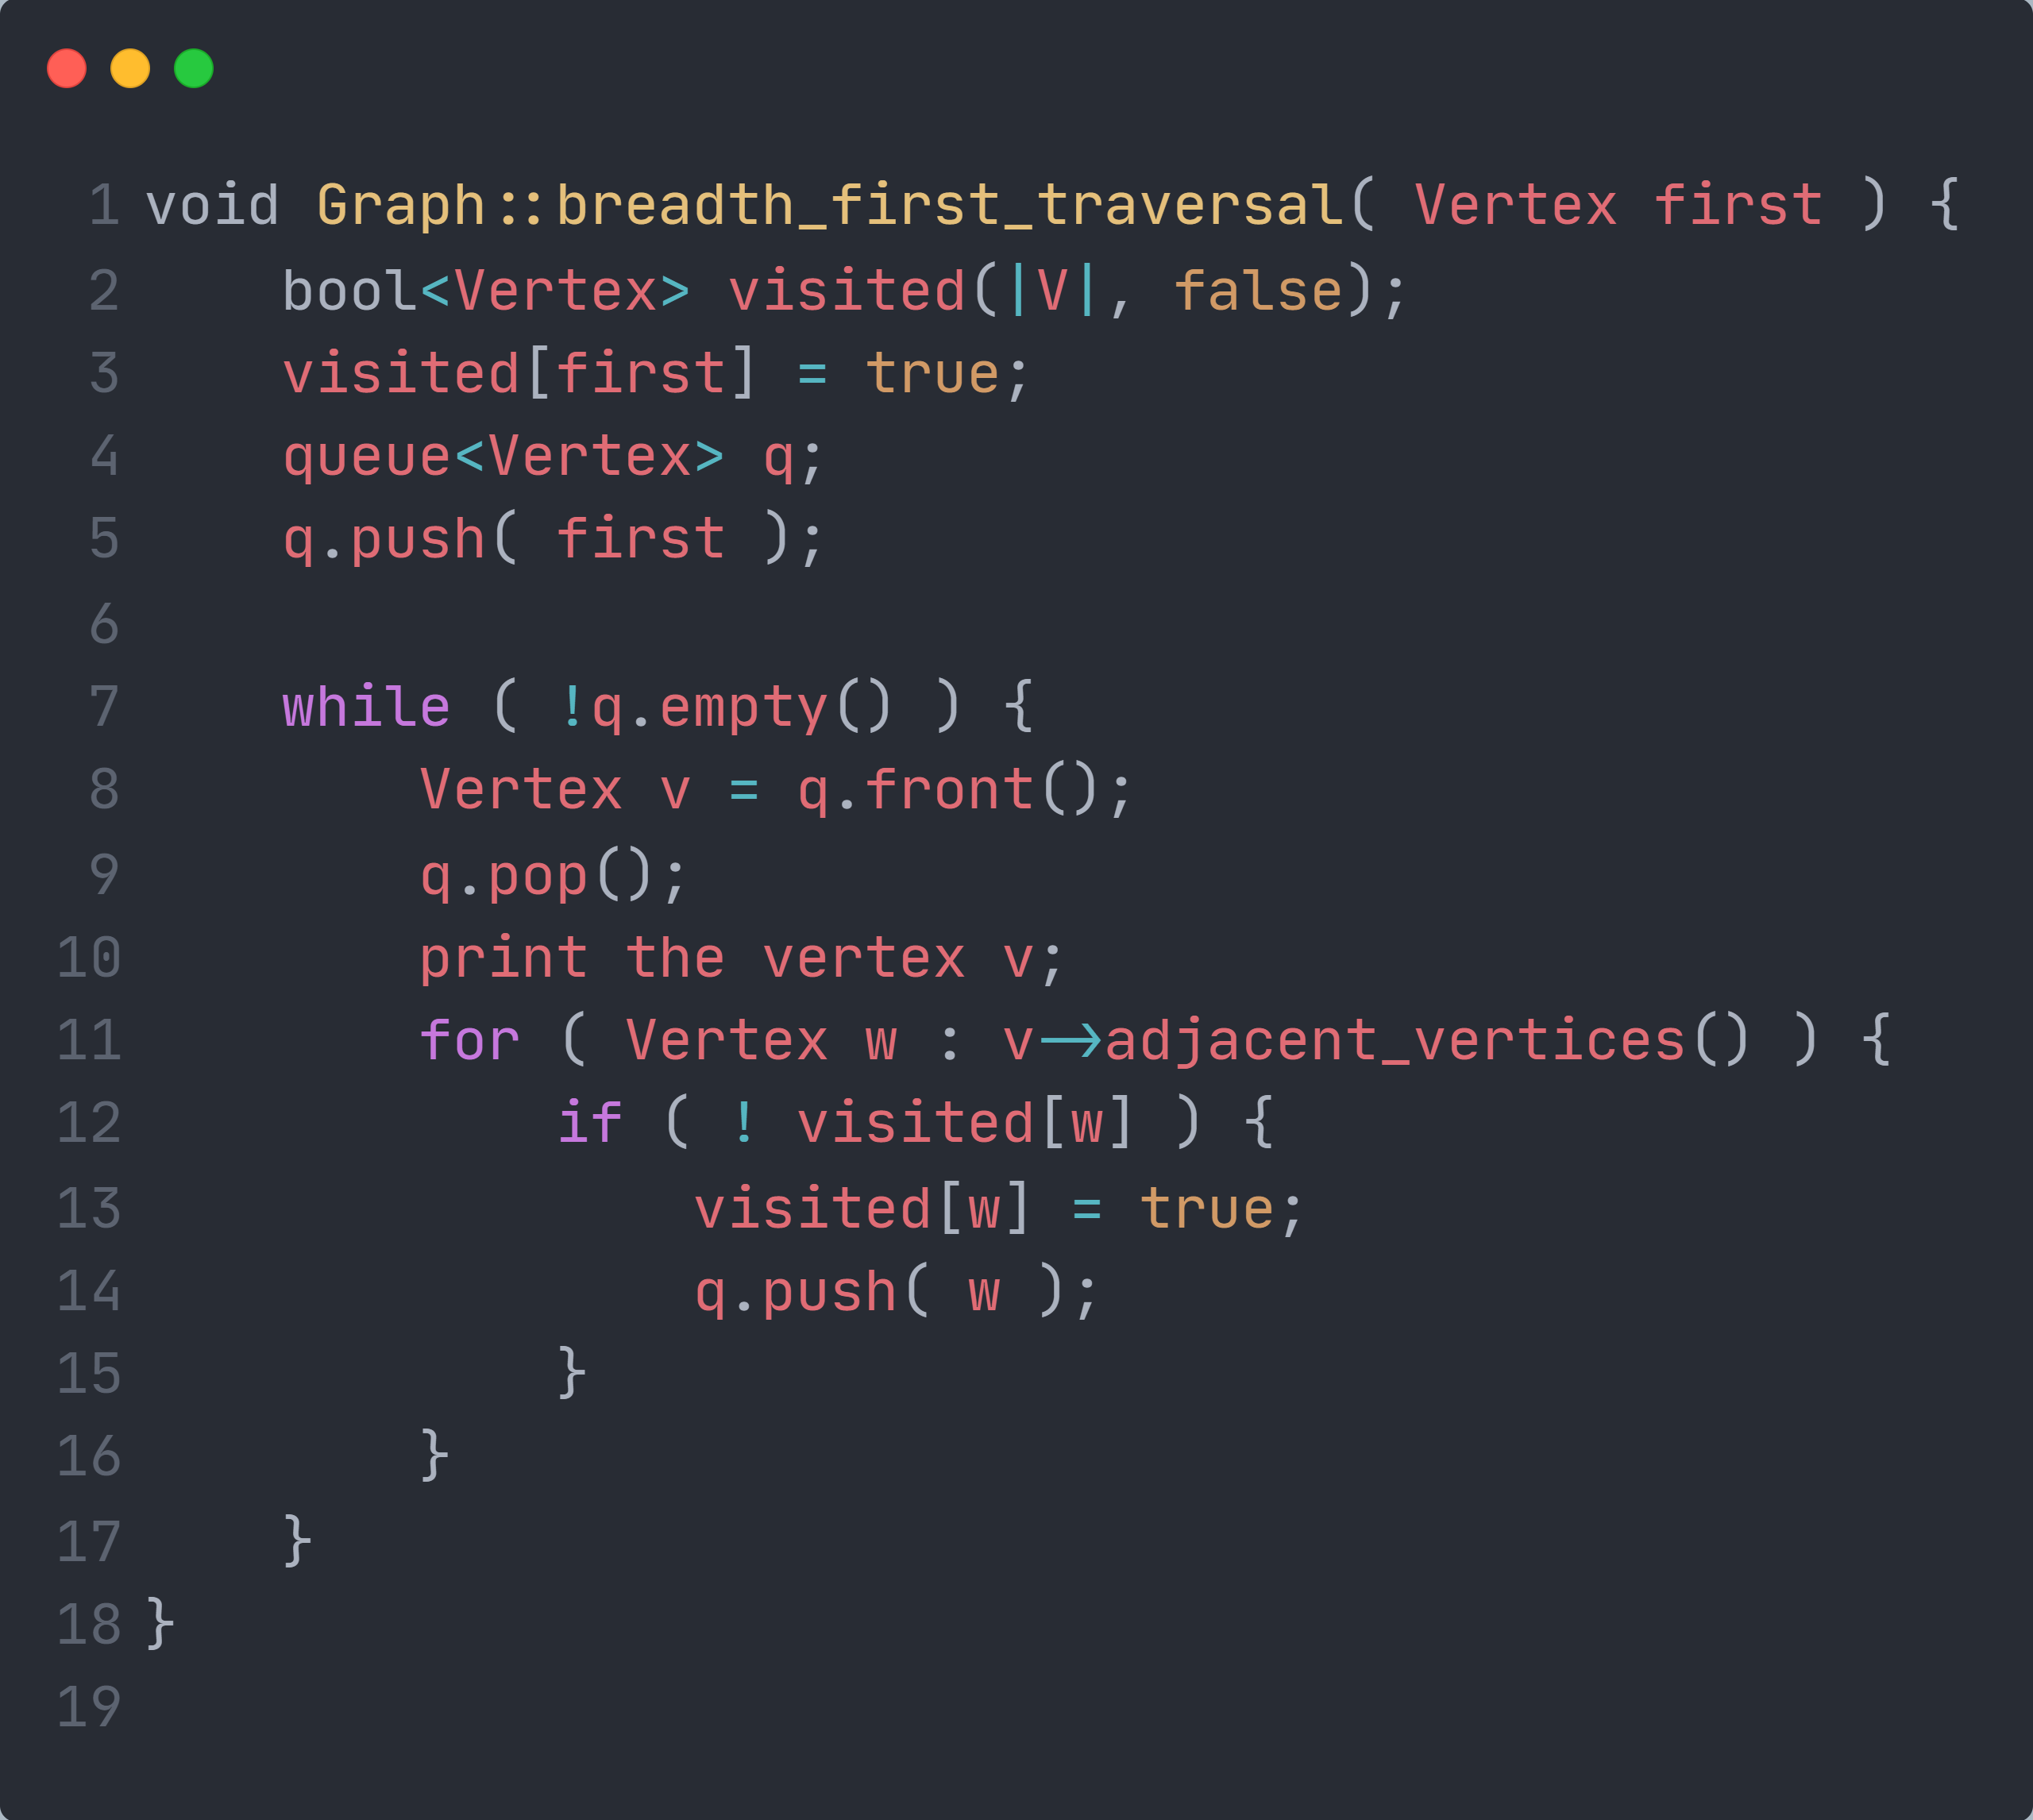
BFS (SSSP for Unweighted Graphs)

Slide 13
Intuition for parallel BFS
We consider unweighted graphs (BFS) below for simplicity.
Solution to the problem can be defined inductively
Here’s the intuition:
DistanceTo(s) = 0
For all neighbors p of s, DistanceTo(p) = 1
For every node u which is the neighbor of some other set of nodes M, DistanceTo(u) = 1 + min(DistanceTo(m), m ∈ M)
d₁
m₁
…
d₂
s
…
n
m₂
…
d₃
m₃

Slide 14
Visualizing Parallel BFS
n₇
n₀
n₁
n₃
n₂
n₆
n₅
n₄
n₈
n₉

Slide 15
From Intuition to Algorithm
Data representation:
Key: node n
Value: d (distance from start), adjacency list (list of nodes reachable from n)
Initialization: for all nodes except for start node, d = ∞
Mapper:
∀m ∈ adjacency list: emit (m, d + 1)
Sort/Shuffle
Groups distances by reachable nodes
Reducer:
Selects minimum distance path for each reachable node
Additional bookkeeping needed to keep track of actual path

Slide 16
BFS in MapReduce
class Mapper method Map(nid n, node N) d ← N.Distance Emit(nid n,N.AdjacencyList) //Pass along graph structure for all nodeid m ∈ N.AdjacencyList do Emit(nid m, d+1) //Emit distances to reachable nodes
class Reducer method Reduce(nid m, [d1, d2, . . .]) d_{min}←∞ M ← ∅ for all d ∈ counts [d1, d2, . . .] do if IsNode(d) then M.AdjacencyList ← d //Recover graph structure else if d < d_{min} then //Look for shorter distance d_{min} ← d M.Distance ← d_{min} //Update shortest distance Emit(nid m, node M)

Slide 17
Multiple Iterations Needed
The input of Mapper is the output of Reducer in the previous iteration.
Multiple iterations are needed to explore entire graph.
Preserving graph structure:
Problem: Where did the adjacency list go?
Solution: mapper emits (n, adjacency list) as well

Slide 18
MapReduce for Graphs?
Graph Computing Paradigm:
Graph algorithms are expressed in multiple MR iterations.
Data must be reloaded and reprocessed at each iteration.
Need an extra MR Job for each iteration to detect termination condition.
Workload unbalance by various vertex degree
For each vertex:
do something;
notify neighbors;

Slide 19
Iterative MapReduce
Iterations
Data
Data
Data
Data
CPU 1
CPU 1
CPU 1
Data
Data
Data
Data
Data
Data
Data
Data
CPU 2
CPU 2
CPU 2
Data
Data
Data
Data
Data
Data
Data
Data
CPU 3
CPU 3
CPU 3
Data
Data
Data
Data
Data
Data
Data
Data
Barrier
Barrier
Barrier
Only a subset of data needs computation:

Slide 20
Iterative MapReduce
Iterations
Data
Data
Data
Data
CPU 1
CPU 1
CPU 1
Data
Data
Data
Data
Data
Data
Data
Data
CPU 2
CPU 2
CPU 2
StartupPenalty
Disk Penalty
Startup Penalty
Disk Penalty
Startup Penalty
Data
Data
Disk Penalty
Data
Data
Data
Data
Data
Data
CPU 3
CPU 3
CPU 3
Data
Data
Data
Data
Data
Data
Data
Data
System is not optimized for iteration:

Slide 21
Pregel for Distributed Graph Processing
Developed by Google
Computing in Bulk Synchronous Parallel (BSP) model
Computes in vertex-centric fashion
Scalable and fault tolerant

Slide 22
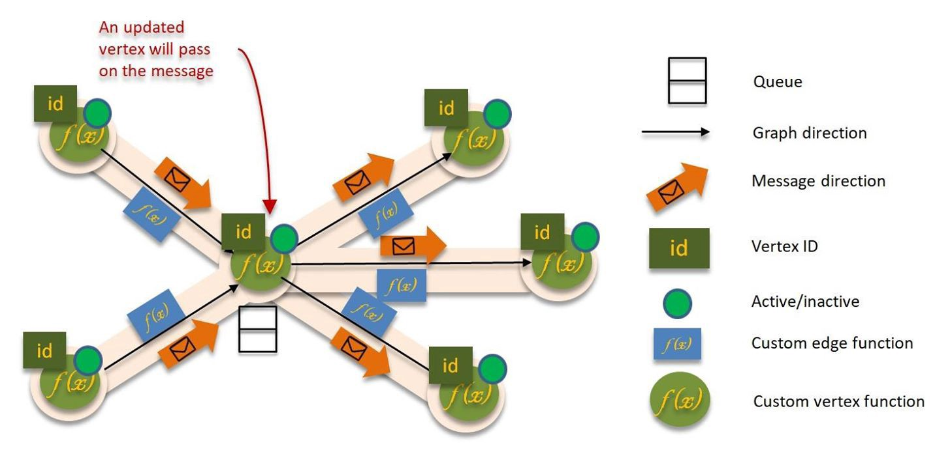
Pregel for Distributed Graph Processing
Think Like a Vertex Model

Slide 23
Bulk Synchronous Parallel (BSP)
- Computations are consist of a sequence of iterations, called superstep.
- During superstep, framework calls user-defined computation function on every vertex.
- Computation function specifies behavior at a single vertex V in a superstep.
- Supersteps end with barrier synchronization.
- All communications are from superstep S to superstep S+1.

Slide 24
Bulk Synchronous Parallel (BSP)
Terminates when all vertices are inactive or no messages to be delivered

Slide 25
Vertex in Pregel
- Can mutate local value and value on outgoing edges.
- Can send arbitrary number of messages to any other vertices.
- Receive messages from previous superstep.
- Can mutate local graph topology.
- All active vertices participate in the computation in a superstep.

Slide 26
Messages
Consists of a message value and destination vertex.
Typically sent along outgoing edges.
Can be sent to any vertex whose identifier is known.
Are only available to receiver at the beginning of superstep.
Guaranteed to be delivered.
Guaranteed not to be duplicated.
Can be out of order.

Slide 27
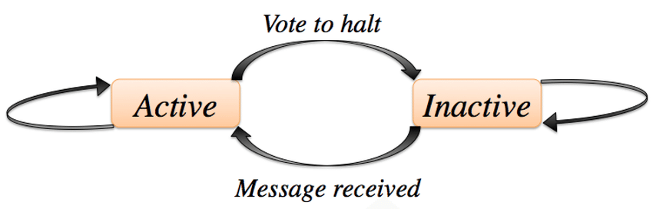
Vertex in Pregel
Initially, every vertices are active.
- A vertex can deactivate itself by vote to halt.
- Deactivated vertices don't participate in computation.
- Vertices are reactivated upon receiving message.

Slide 28
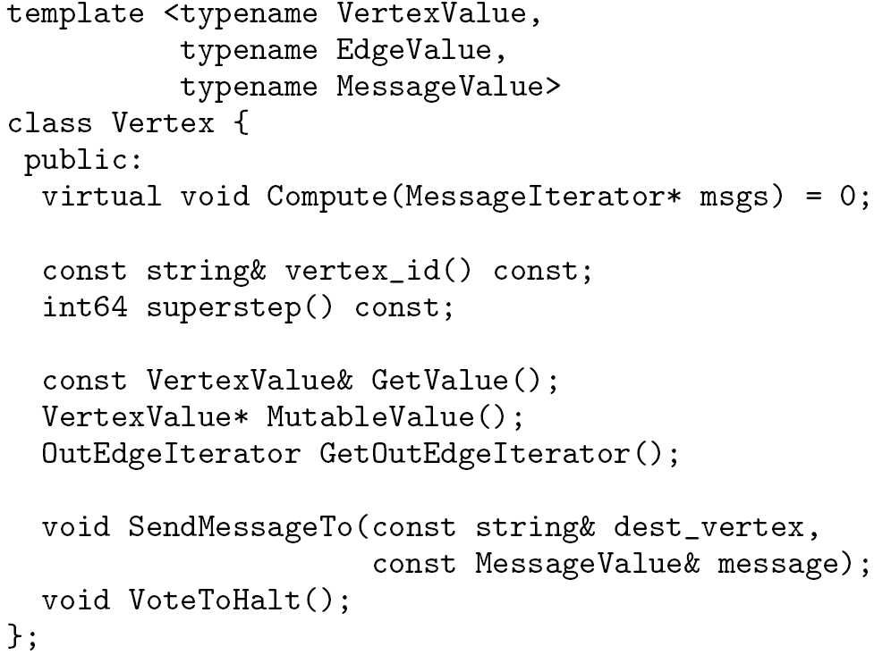
The C++ API of Pregel
Override this!
in msgs
Modify vertex value
out msg

Slide 29
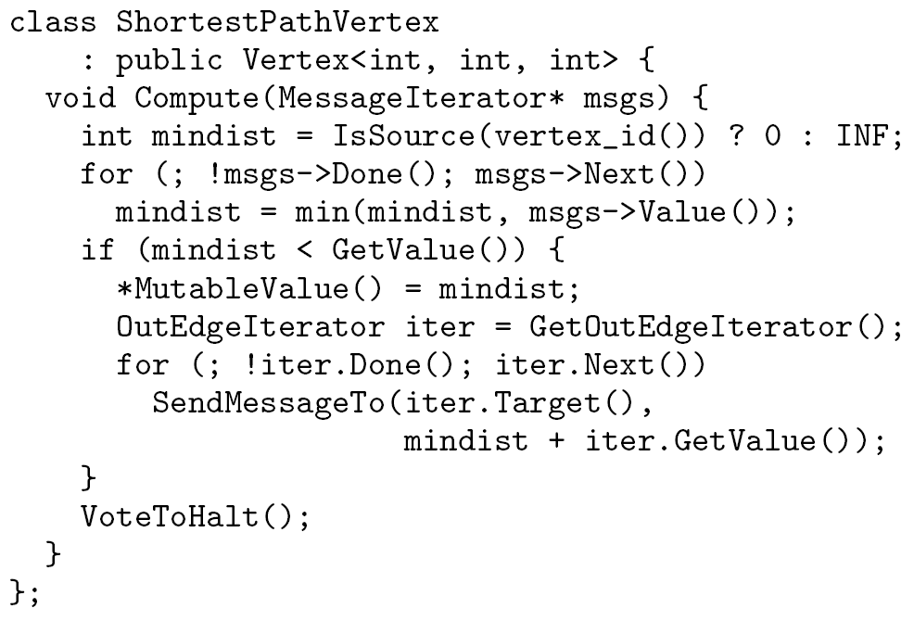
Implementation for SSSP

Slide 30
Single-Source Shortest Path (SSSP) in Pregel
∞
∞
1
10
0
2
3
9
4
6
Inactive Vertex
Active Vertex
5
7
x
Edge weight
∞
∞
x
Message
2
0 is the source vertex

Slide 31
SSSP in Pregel
∞
∞
∞
1
10
10
∞
∞
∞
0
Inactive Vertex
∞
2
3
9
4
6
Active Vertex
x
Edge weight
5
∞
7
∞
x
Message
5
∞
∞
2
∞

Slide 32
SSSP in Pregel
10
∞
1
10
0
Inactive Vertex
2
3
9
4
6
Active Vertex
x
Edge weight
5
7
x
Message
5
∞
2

Slide 33
SSSP in Pregel
10
11
∞
1
14
10
8
0
Inactive Vertex
2
3
9
4
6
Active Vertex
x
Edge weight
5
12
7
x
Message
5
∞
2
7

Slide 34
SSSP in Pregel
8
11
1
10
0
Inactive Vertex
2
3
9
4
6
Active Vertex
x
Edge weight
5
7
x
Message
5
7
2

Slide 35
SSSP in Pregel
8
9
11
1
10
13
0
Inactive Vertex
14
2
3
9
4
6
Active Vertex
x
Edge weight
5
7
15
x
Message
5
7
2

Slide 36
SSSP in Pregel
8
9
1
10
0
Inactive Vertex
2
3
9
4
6
Active Vertex
x
Edge weight
5
7
x
Message
5
7
2

Slide 37
SSSP in Pregel
8
9
1
10
0
Inactive Vertex
2
3
9
4
6
Active Vertex
x
Edge weight
5
7
13
x
Message
5
7
2

Slide 38
SSSP in Pregel
8
9
1
10
0
Inactive Vertex
2
3
9
4
6
Active Vertex
x
Edge weight
5
7
x
Message
5
7
2

Slide 39
Combiner in Pregel
Sending messages incurs overhead.
System calls Combine() for several messages intended for a vertex into a single message containing the combined message.
No guarantees which messages will be combined or the order of combination.
Should be enabled for commutative and associative messages.
Not enabled by default.

Slide 40
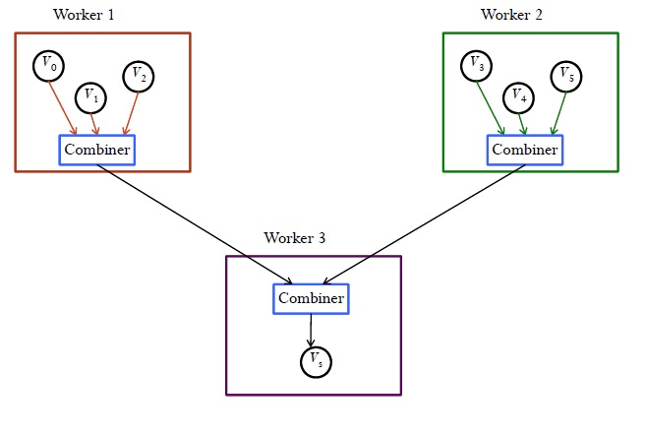
Combiner in Pregel (Cont.)
Reduce message traffic and disk space

Slide 41
Combiner in SSSP
class MinIntCombiner : public Combiner<int> {
virtual void Combine(MessageIterator* msgs) {
int mindist = INF;
for (; !msgs->Done(); msgs->Next())
mindist = min(mindist, msgs->Value());
Output("combined_source", mindist);
}
};

Slide 42
Others in Pregel
Aggregator
Used for global communication, global data and monitoring
Topology Mutations
Fault Tolerance
Checking point, failure detection, recovery . . .

Slide 43
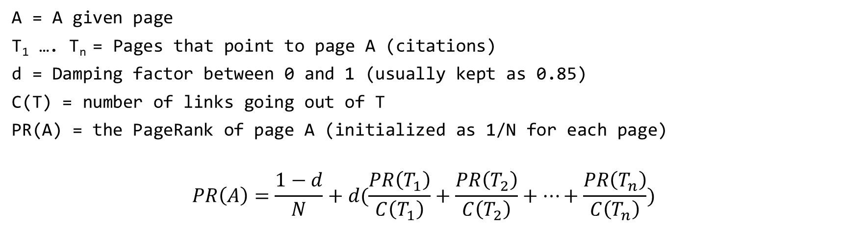
Pagerank
Used to determine the importance of a document based on the number of references to it and the importance of the source documents themselves.
A = A given page
T₁ …. T_{n} = Pages that point to page A (citations)
d = Damping factor between 0 and 1 (usually kept as 0.85)
C(T) = number of links going out of T
PR(A) = the PageRank of page A (initialized as 1/N for each page)
$$PR\left(A\right)=\frac{1−d}{N}+d(\frac{PR\left(T_{1}\right)}{C\left(T_{1}\right)}+\frac{PR\left(T_{2}\right)}{C\left(T_{2}\right)}+…+\frac{PR\left(T_{n}\right)}{C\left(T_{n}\right)})$$

Slide 44
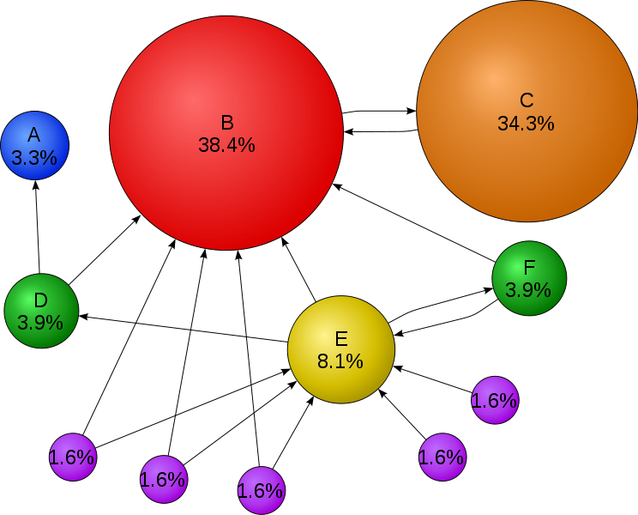
Pagerank

Slide 45
Pagerank in Pregel
Superstep 0: Value of each vertex is 1/NumVertices()
virtual void Compute(MessageIterator* msgs) {
if (superstep() >= 1) {
double sum = 0;
for (; !msgs->done(); msgs->Next())
sum += msgs->Value();
*MutableValue() = 0.15/NumVertices() + 0.85 * sum;
}
if (supersteps() < 30) {
const int64 n = GetOutEdgeIterator().size();
SendMessageToAllNeighbors(GetValue() / n); } else {
VoteToHalt();
}
}

Slide 46
Combiner for Pagerank?
virtual void Combine(MessageIterator* msgs) {
}

Slide 47
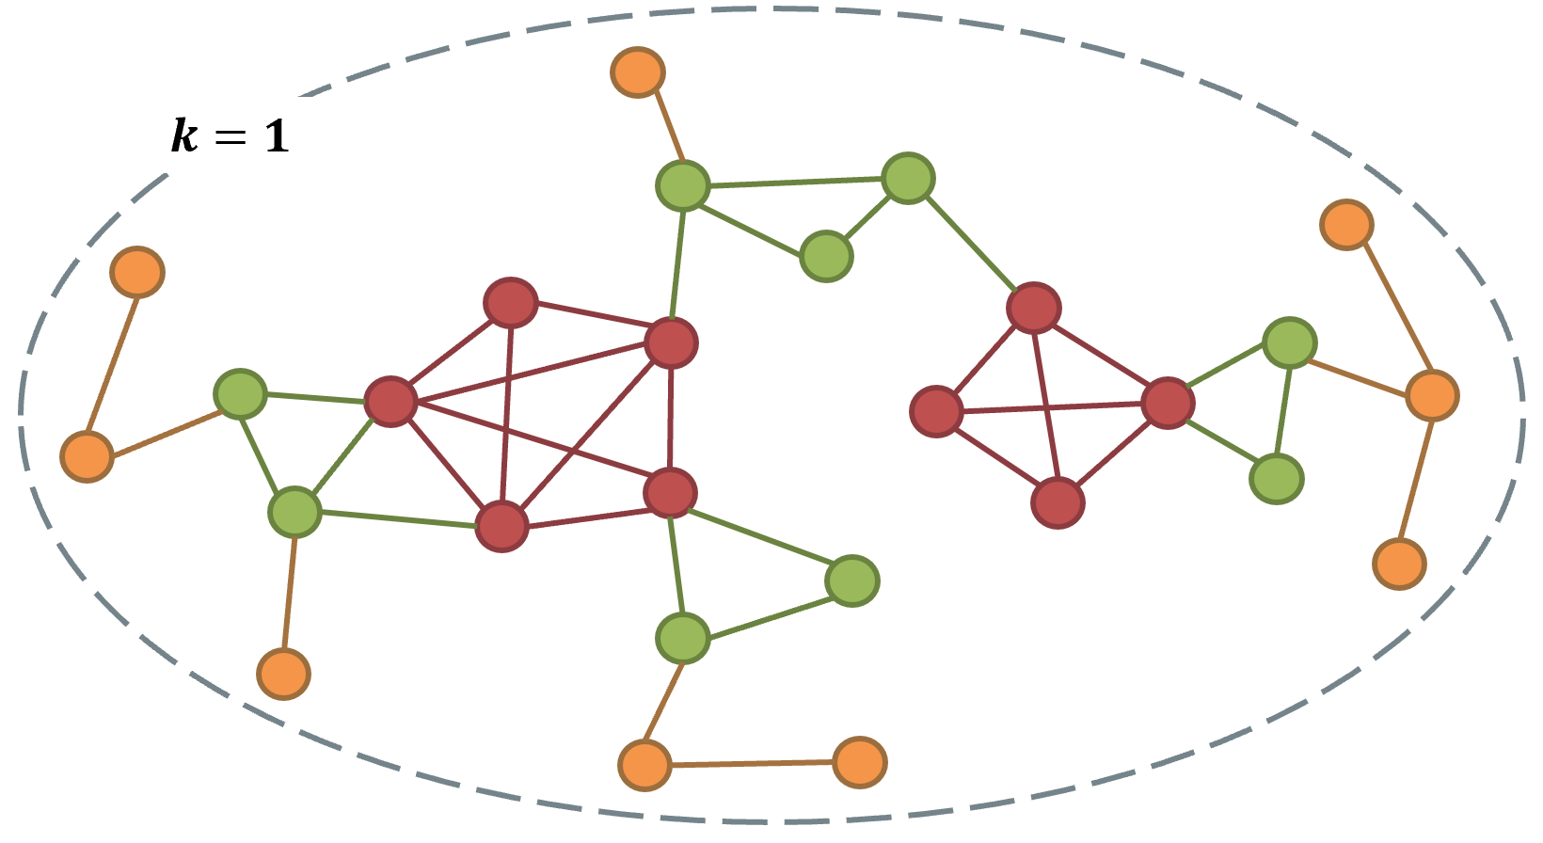
Core Decomposition
For each unvisited vertex u with the lowest degree in G
assign core(u) as degree(u);
mark u as visited;
decrease the degree of its unvisited neighbors with higher degree than u by 1;
The peeling algorithm for core decomposition is hard to parallelize.

Slide 48
Core Decomposition: Local-view (Converging)
Locality Theorem:
Given a vertex and its core number k:
There exists at least k neighbors with core number k;
There does not exist k+1 neighbors with core number k+1.
3
4
3
4
4
Core(V) = 3
4 neighbors with core number at least 3
√
3
v
3
v
6
v
6
6
Core(V) = 4
Only 2 neighbors with core number at least 4
×
1
2
Montresor, Alberto, Francesco De Pellegrini, and Daniele Miorandi. "Distributed k-core decomposition." IEEE Transactions on parallel and distribuated systems 24.2 (2013): 288-300.

Slide 49
Quiz
What is the core number of v?
4
3
5
3
3
v
2
v
6
v
1
2

Slide 50
Core Decomposition: Local-view (Converging)
v₀
v₆
v₇
Given a vertex and its core number k:
There exists at least k neighbors with core number k;
There does not exist k+1 neighbors with core number k+1.
v₃
v₅
v₁
v₄
v₈
v₂
False
True
Initialize the core number by degree
Iteration 1
isContinue:
ID
0
1
2
3
4
5
6
7
8
Core
3
3
4
6
3
5
3
2
1

Slide 51
Core Decomposition: Local-view (Converging)
v₀
v₆
v₇
Given a vertex and its core number k:
There exists at least k neighbors with core number k;
There does not exist k+1 neighbors with core number k+1.
v₃
v₅
v₁
v₄
v₈
v₂
False
True
Initialize the core number by degree
Iteration 1
isContinue:
ID
0
1
2
3
4
5
6
7
8
Core
3
3
4
6
3
5
3
2
1

Slide 52
Core Decomposition: Local-view (Converging)
v₀
v₆
v₇
Given a vertex and its core number k:
There exists at least k neighbors with core number k;
There does not exist k+1 neighbors with core number k+1.
v₃
v₅
v₁
v₄
v₈
v₂
True
False
True
Initialize the core number by degree
Iteration 1
isContinue:
ID
0
1
2
3
4
5
6
7
8
Core
3
3
3
4
6
3
5
3
2
1
Notes:
???

Slide 53
Core Decomposition: Local-view (Converging)
v₀
v₆
v₇
Given a vertex and its core number k:
There exists at least k neighbors with core number k;
There does not exist k+1 neighbors with core number k+1.
v₃
v₅
v₁
v₄
v₈
v₂
True
False
True
Initialize the core number by degree
Iteration 1
isContinue:
ID
0
1
2
3
4
5
6
7
8
Core
3
3
3
4
3
6
3
5
3
2
1

Slide 54
Core Decomposition: Local-view (Converging)
v₀
v₆
v₇
Given a vertex and its core number k:
There exists at least k neighbors with core number k;
There does not exist k+1 neighbors with core number k+1.
v₃
v₅
v₁
v₄
v₈
v₂
True
Fals
True
Initialize the core number by degree
Iteration 1
isContinue:
ID
0
1
2
3
4
5
6
7
8
Core
3
3
4
3
3
6
3
5
3
2
1

Slide 55
Core Decomposition: Local-view (Converging)
v₀
v₆
v₇
Given a vertex and its core number k:
There exists at least k neighbors with core number k;
There does not exist k+1 neighbors with core number k+1.
v₃
v₅
v₁
v₄
v₈
v₂
True
False
True
Initialize the core number by degree
Iteration 1
isContinue:
ID
0
1
2
3
4
5
6
7
8
Core
3
3
4
3
3
6
3
5
3
3
2
1

Slide 56
Core Decomposition: Local-view (Converging)
v₀
v₆
v₇
Given a vertex and its core number k:
There exists at least k neighbors with core number k;
There does not exist k+1 neighbors with core number k+1.
v₃
v₅
v₁
v₄
v₈
v₂
False
True
isContinue:
Initialize the core number by degree
Iteration 1
True
ID
0
1
2
3
4
5
6
7
8
Core
3
3
4
3
3
6
3
5
3
2
3
2
1

Slide 57
Core Decomposition: Local-view (Converging)
v₀
v₆
v₇
Given a vertex and its core number k:
There exists at least k neighbors with core number k;
There does not exist k+1 neighbors with core number k+1.
v₃
v₅
v₁
v₄
v₈
v₂
False
True
True
Initialize the core number by degree
Iteration 1
isContinue:
ID
0
1
2
3
4
5
6
7
8
Core
3
3
4
3
3
6
3
5
3
2
3
2
1

Slide 58
Core Decomposition: Local-view (Converging)
v₀
v₆
v₇
Given a vertex and its core number k:
There exists at least k neighbors with core number k;
There does not exist k+1 neighbors with core number k+1.
v₃
v₅
v₁
v₄
v₈
v₂
True
False
True
Initialize the core number by degree
Iteration 1
isContinue:
ID
0
1
2
3
4
5
6
7
8
Core
3
3
4
3
3
6
3
5
3
2
3
2
1

Slide 59
Core Decomposition: Local-view (Converging)
v₀
v₆
v₇
Given a vertex and its core number k:
There exists at least k neighbors with core number k;
There does not exist k+1 neighbors with core number k+1.
v₃
v₅
v₁
v₄
v₈
v₂
True
Initialize the core number by degree
Iteration 1
isContinue:
ID
0
1
2
3
4
5
6
7
8
Core
3
3
4
3
3
6
3
5
3
2
3
2
1

Slide 60
Core Decomposition: Local-view (Converging)
v₀
v₆
v₇
Given a vertex and its core number k:
There exists at least k neighbors with core number k;
There does not exist k+1 neighbors with core number k+1.
v₃
v₅
v₁
v₄
v₈
v₂
False
True
Initialize the core number by degree
Iteration 1
isContinue:
2
ID
0
1
2
3
4
5
6
7
8
Core
3
3
4
3
3
6
3
5
3
2
3
2
1

Slide 61
Core Decomposition: Local-view (Converging)
v₀
v₆
v₇
Given a vertex and its core number k:
There exists at least k neighbors with core number k;
There does not exist k+1 neighbors with core number k+1.
v₃
v₅
v₁
v₄
v₈
v₂
True
Initialize the core number by degree
Iteration 1
isContinue:
False
2
ID
0
1
2
3
4
5
6
7
8
Core
3
3
4
3
3
6
3
2
5
3
2
3
2
1

Slide 62
Core Decomposition: Local-view (Converging)
v₀
v₆
v₇
Given a vertex and its core number k:
There exists at least k neighbors with core number k;
There does not exist k+1 neighbors with core number k+1.
v₃
v₅
v₁
v₄
v₈
v₂
True
True
False
Initialize the core number by degree
Iteration 1
isContinue:
2
3
ID
0
1
2
3
4
5
6
7
8
Core
3
3
4
3
3
6
3
2
2
5
3
2
3
2
1

Slide 63
Core Decomposition: Local-view (Converging)
v₀
v₆
v₇
Given a vertex and its core number k:
There exists at least k neighbors with core number k;
There does not exist k+1 neighbors with core number k+1.
v₃
v₅
v₁
v₄
v₈
v₂
True
False
True
Fals
Iteration 1
isContinue:
Initialize the core number by degree
4
2
3
ID
0
1
2
3
4
5
6
7
8
Core
3
3
4
3
3
6
3
2
2
5
3
2
3
2
1

Slide 64
Core Decomposition Pregel
virtual void Compute(MessageIterator* msgs) {
oldValue = GetValue()
*MutableValue() = compute core number from the neighbor’s core numbers in msgs based on the locality theorem
if (GetValue() != oldValue){
SendMessageToAllNeighbors(GetValue());
}else{
VotetoHalt();
}
}

Slide 65
Connected Component Detection in Pregel
A basic distributed algorithm to compute connected components:
virtual void Compute(MessageIterator* msgs) {
int minID = GetValue();
for (; !msgs->done(); msgs->Next())
minID = min(minID,msg->Value());
}
if (minID < GetValue()){
*MutableValue() = minID;
SendMessageToAllNeighbors(minID);
}
VoteToHalt();
}

Slide 66
Graph Database

Slide 67
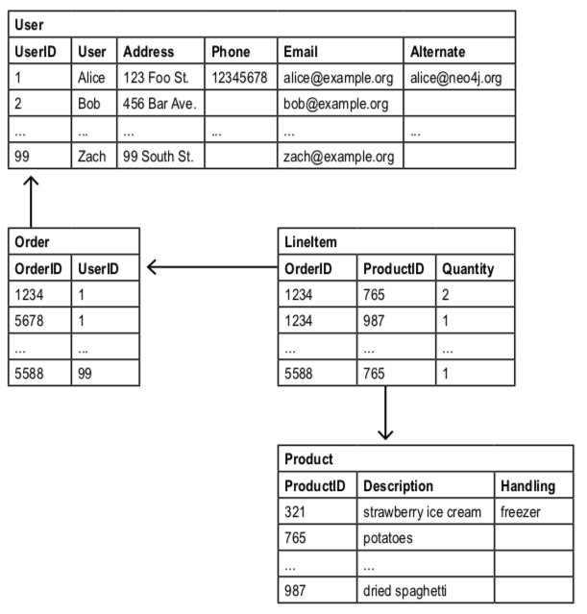
Drawbacks of Relational Databases
Schema are inflexible
Missing values
Business Requirements change quickly
Inefficient
Consider the E-Commerce example
What items did a customer buy?
Which customers bought this product?
A basic query for recommendation: Which customers buying this product also bought that product?
NoSQL database faces the similar issue

Slide 68
Drawbacks of Relational Databases (Cont.)
BFS in RDBMS need many interaction operations~
id | node1 | node2
------------------
0 | 0 | 1
1 | 2 | 4
2 | 1 | 3
3 | 1 | 2
4 | 5 | 2
5 | 3 | 4
...

Slide 69
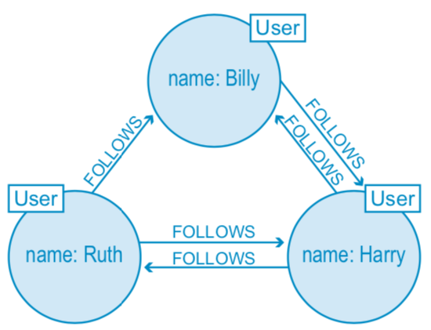
What is a Graph Database?
A database consists of entities and their relationships
An entity is modelled as a node (with arbitrary number of attributes).
A relationship is modelled as an edge (possibly with labels or weights)
No background of graph theory is needed to query a graph database
More intuitive to understand than an relational database management systems (RDBMS)

Slide 70
Why we care about Graph Database~
Performance
Traditional Joins are inefficient
Billion-scale data are common, e.g., Facebook social network , Google web graph
Flexibility
Real-world entities may not have a fixed schema. It is not feasible to design 1000 attributes for a table.
Relationships among entities can be arbitrary. It is not feasible to use 1000 tables to model 1000 types of relationships.
Agility
Business requirements changes over time
Today’s development practices are agile, test-driven

Slide 71
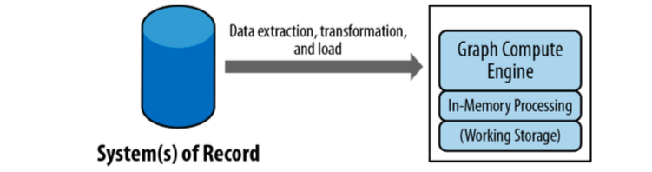
How a graph database works
Graph Storage
Usually use the native graph structure, e.g., adjacency lists.
Efficient and easy to develop graph algorithms.
Graph Processing Engine
Algorithms and queries supported based on the graph storage
Native graph processing is more efficient

Slide 72
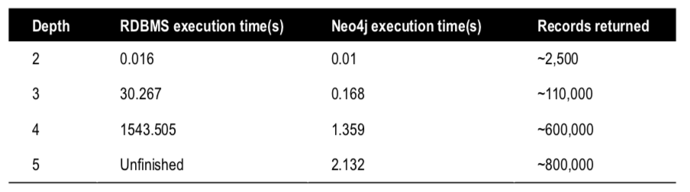
Graph DB VS RDBMS
An Example:
Data: a social network of 1,000,000 people each with approximately 50 friends
Query: to find friends-of-friends connections to a depth of five degrees.
Efficiency Comparison:

Slide 73
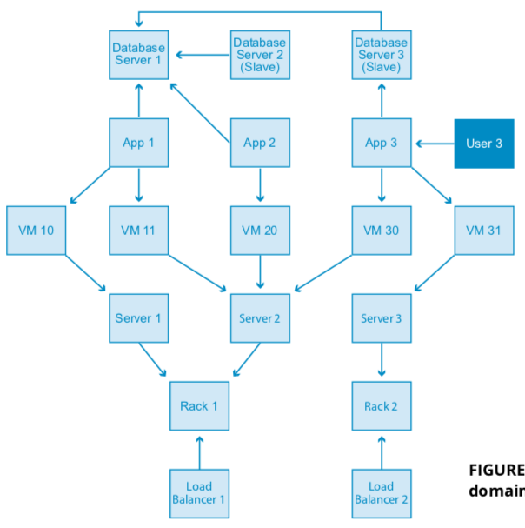
Data Modelling: RDBMS vs Graph DB
An Example: In this data center management domain, several data centers support a few applications using infrastructure like virtual machines and load balancers.
The “whiteboard” form is shown on the right

Slide 74
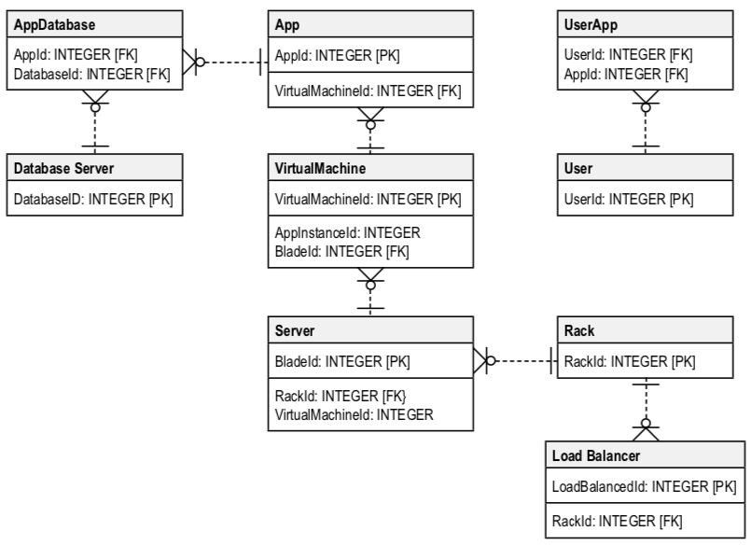
Data Modelling in RDBMS
Data Model in RDBMS
Aim: From initial whiteboard to relations
Step 1: design schema for each table (consider data redundancy, efficiency, …)
Step 2: design primary key (PK) and foreign key (FK)
Step 3: insert data for each table following the schema
Step 4: query the RDBMS using SQL
Needs careful modelling

Slide 75
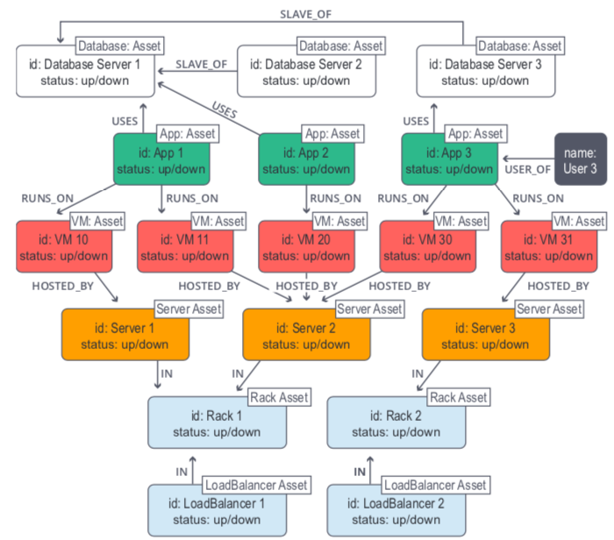
Data Modelling in Graph DB
Data Model in Graph DB
Aim: From initial whiteboard to Graph DB
Step 1: insert data for entities and relationships
Step 2: query the Graph DB
Looks just as what they are on the whiteboard
No schema but highly expressive.
New types of data can be easily integrated
We need a query language

Slide 76
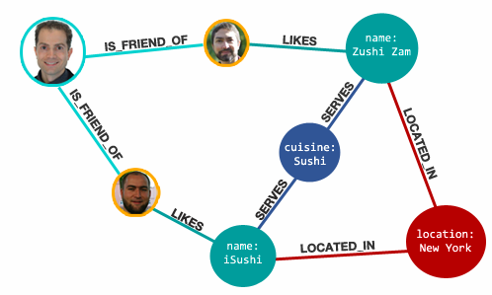
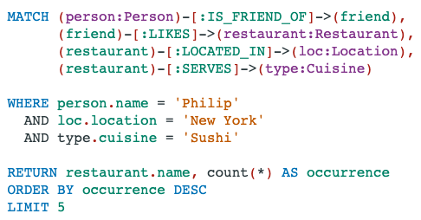
Cypher: the graph query language in Neo4j
Optional
An example of Cypher:
Find Sushi restaurants in New York
that my friend Philip like

Slide 77
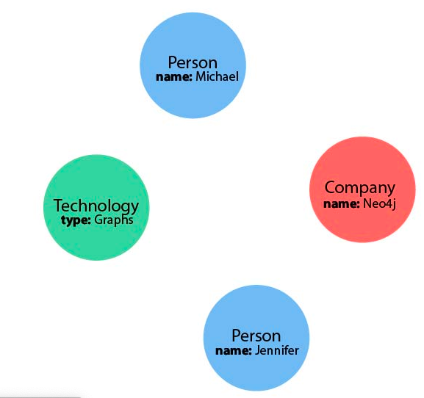
Representing Nodes in Cypher
() //anonymous node (no label or variable) can refer to any node in the database
(p:Person) //using variable p and label Person
(:Technology) //no variable, label Technology
(work:Company) //using variable work and label Company

Slide 78
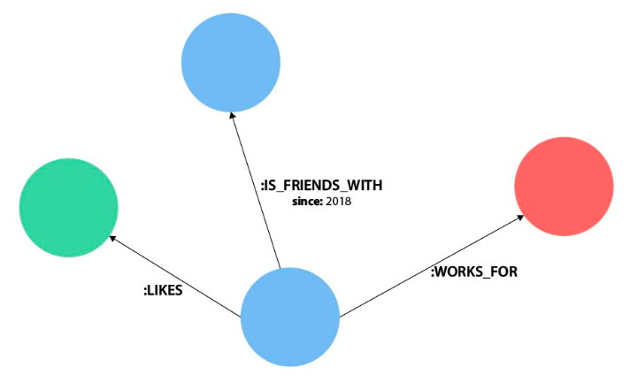
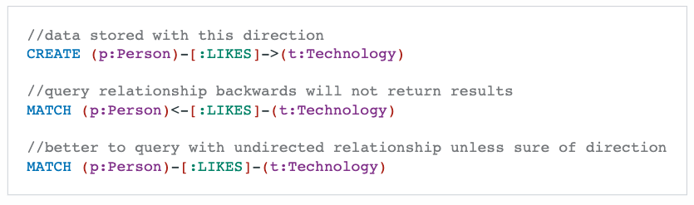
Representing Relationships in Cypher
-- or --> or <-- //anonymous relationship
-[rel]-> //using variable rel to denote a relationship of any label
-[rel:LIKES]-> //using variable rel to denote a relationship of label LIKES
-[:LIKES]-> //denote a relationship of label LIKES

Slide 79
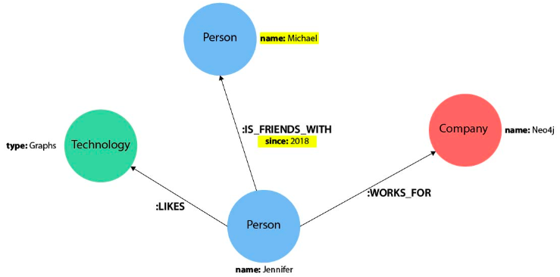
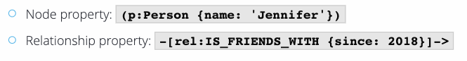
Node or Relationship Properties

Slide 80
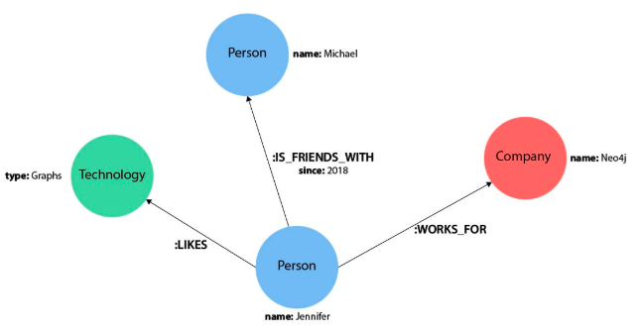

Find nodes by relationships

Slide 81


Create a node

Slide 82
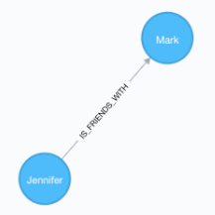

Create a relationship

Slide 83
Other operations
Create/modify/delete nodes/edges/properties
Merge nodes
Selection
. . .

Slide 84
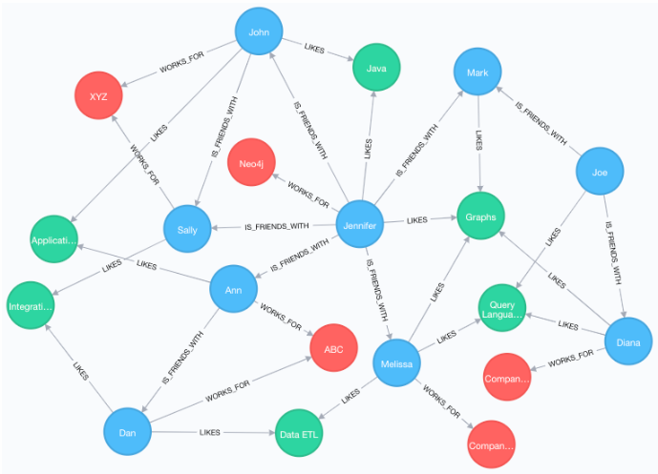
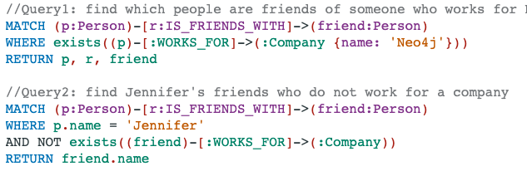
Some Complex Patterns

Slide 85

Some Complex Patterns (Cont.)
//Find who likes graphs besides Jennifer
MATCH (j:Person {name: 'Jennifer'})-[r:LIKES]-(graph:Technology {type: 'Graphs'})-[r2:LIKES]-(p:Person)
RETURN p.name

Slide 86

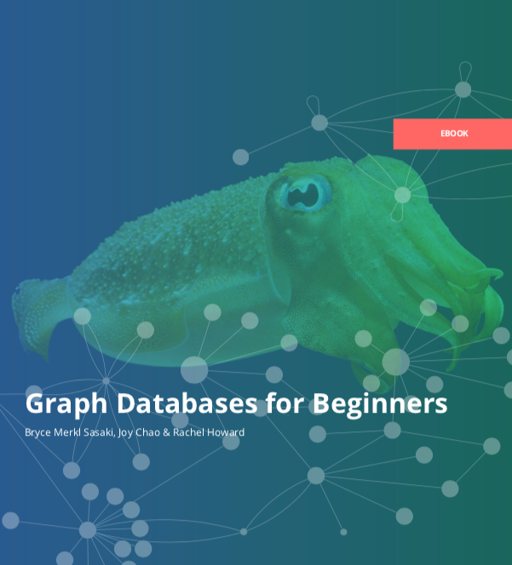
Resources
More resources can be found on neo4j.com

Slide 87
Other Graph Algorithms

Slide 88
Graph Similarity
Different measures between graphs:
Distance based on maximum common subgraphs,
Distance based on spectral characteristics,
Graph kernels (simmilarities),
Graph Edit distance.
A nice tutorial in SDM 2014:
https://web.eecs.umich.edu/~dkoutra/tut/sdm14.html

Slide 89
Graph Edit Distance
An edit path between a graph A and a graph B is a sequence of node or edge insertion, removal or substitution which transforms A to B.

Slide 90
Graph Edit Distance (Cont.)
The graph edit distance (GED) between A and B is the smallest number of operations that can transform A to B.
Computing GED is NP-hard~

Slide 91








RESEARCH
ON GRAPH:
GRAPH PROBLEM
Link Analysis (relevance)
Pagerank
GRAPH MODEL
APPLICATION
SimRank
Link Prediction
Clustering
Traditional Graph
Recommendation
REAL DATA
Degree/Neighbors (structural)
Streaming Graph
Cluster Coefficient
Triangle
Vertex Cover
Anomaly Detection
Money Transactions
Visualization
Heterogeneous Graph
Distance/Path (reachability)
Reachability
Protein Interactions
Cybersecurity
Knowledge Graph
Shortest Path
Spanning Tree
Steiner Tree
Internet
System
K-Hop
Centrality
KNN
Keyword Search
Fraud Detection
Medical Records
Attributed Graph
Subgraph Detection
Marketing
Graph Similarity
Phone Calls
Temporal Graph
Cohesive Subgraph
Subgraph Enumeration
Legal Reasoning
Road Map
Promotion
Evolving Graph
Propagation
Influence Maximization
Social Network
Traffic Monitoring
. . .
Uncertain Graph
Information Cascade
Label Propagation
. . .
Node mapping (Embedding)
Virus Control
. . .
Node2Vec
AI4DB
Graph Analytics System
Graph Database

Slide 92
Learning outcome
We did not introduce too many algorithms in COMP9312, but there are some implementation details you need to consider even only about graph storage and very fundamental algorithms like connected component detection.
Depth
Breath
When you implement some ideas in the future, whatever programming language you use, think about how we optimize the algorithm. When designing and implementing algorithms, one small step forward may significantly improve efficiency and reduce space usage.

